Slide 1
Jo’s Portfolio
(WIP)

Slide 2
Portfolio/Website Contents
Name and Contact
Github and LinkedIn
Projects
Resume (link to pdf)
Skills, Interests (About Me+)
Blog (list of posts with titles and dates)
Blog (sample posts)

Slide 3

Sitemap
Home
About Me
Blog
Projects

Slide 4
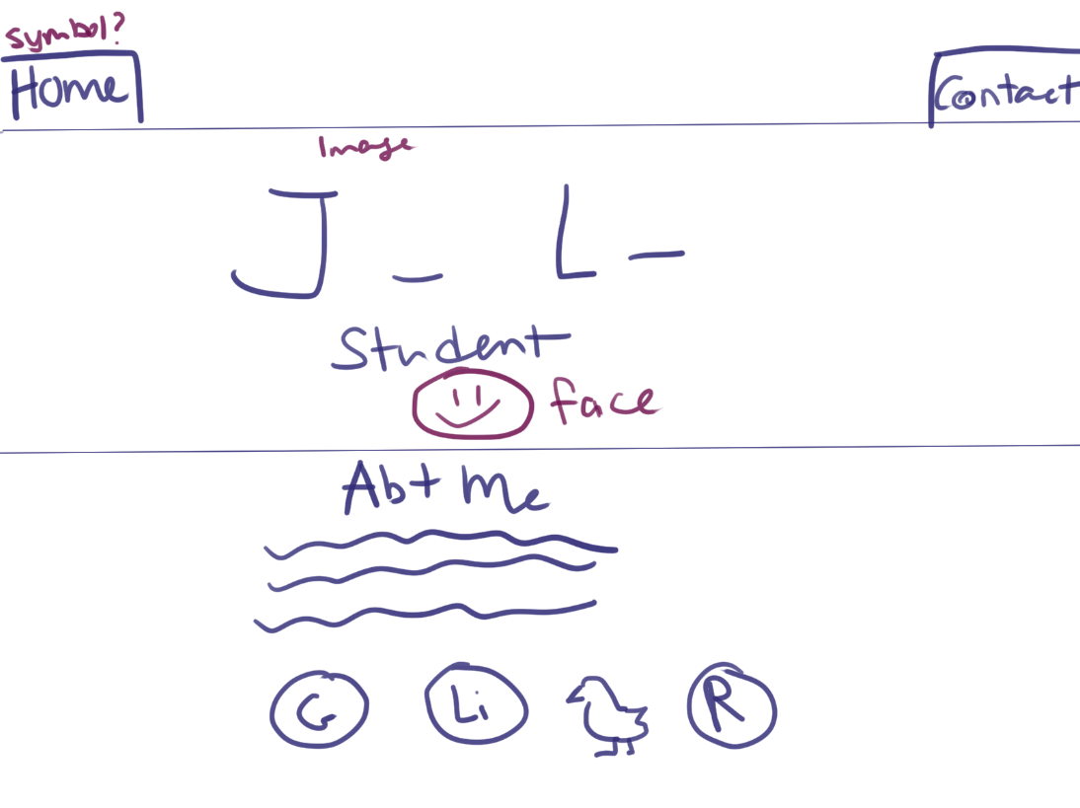
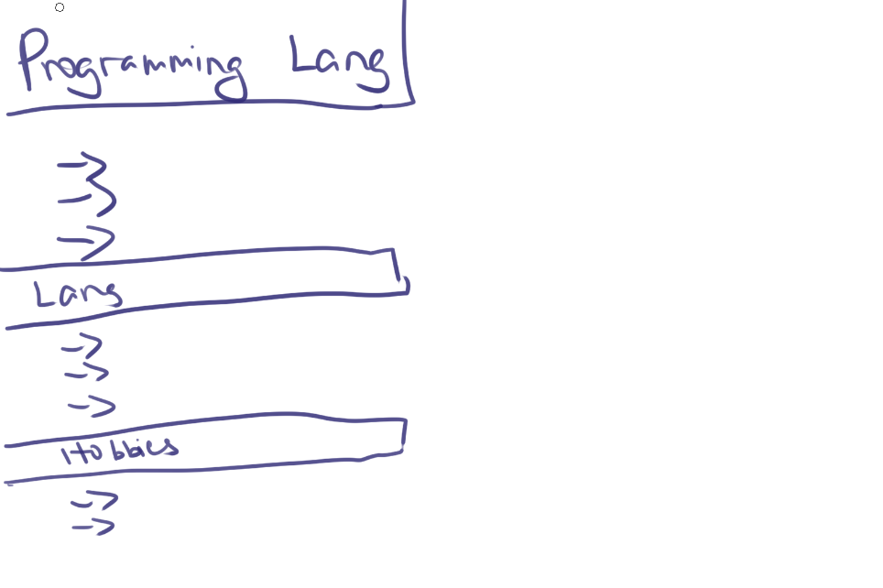
Wireframing (Home)

Slide 5
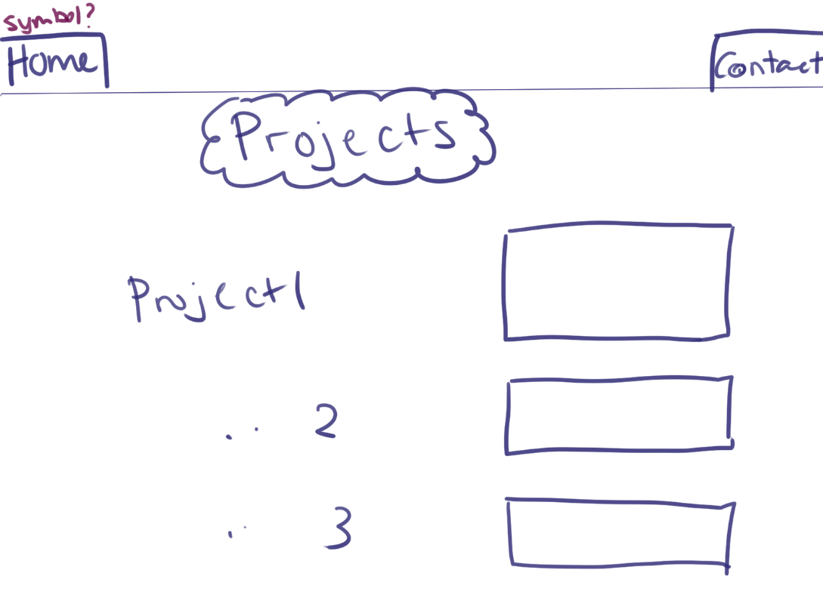
Wireframing (Projects)

Slide 6
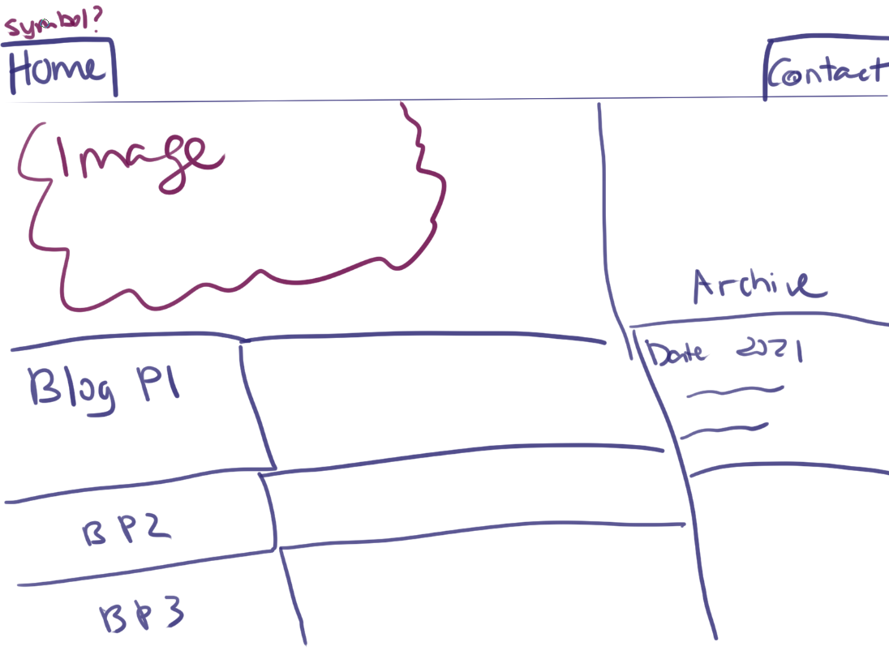
Wireframing (Blog)

Slide 7
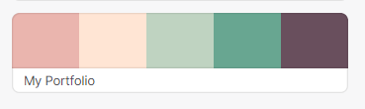
To add/continue to fiddle with
Hover highlight
Re-sizing images for quick load times
Favicon
Make blog look pretty

Slide 8


To add/continue to fiddle with
Flower theme
Colour palette
Home page symbol/logo
Responsive Design

Slide 9
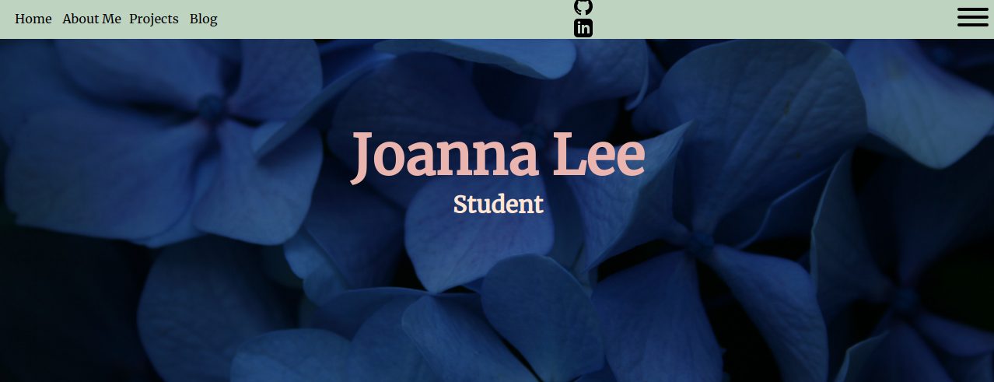

Home

Slide 10
Challenges and Considerations
Give lots of info – but not overwhelm
Workable in both mobile and desktop
Consistency (no broken links – lots of testing)
User friendly (logos/symbols not too obtuse)
Aesthetically pleasing and simple
Crediting images used

